Slide 1
18ITT42 - DESIGN AND ANALYSIS OF ALGORITHMS (IV-Semester)
Velalar College of Engineering and Technology
(Autonomous)
Department of CSE
(Accredited by NBA)
Handled By:
Dr.V.Latha Jothi , Professor

Slide 2
UNIT – 1 ALGORITHM ANALYSIS
Introduction : Notion of Algorithm – Fundamentals of Algorithmic problem Solving – Important Problem types.
Fundamentals of the Analysis of Algorithm Efficiency : Analysis Framework – Asymptotic notations and Basic Efficiency Classes - Mathematical Analysis of Recursive and Non-recursive algorithms-Empirical analysis of Algorithms-Algorithm Visualization

Slide 3
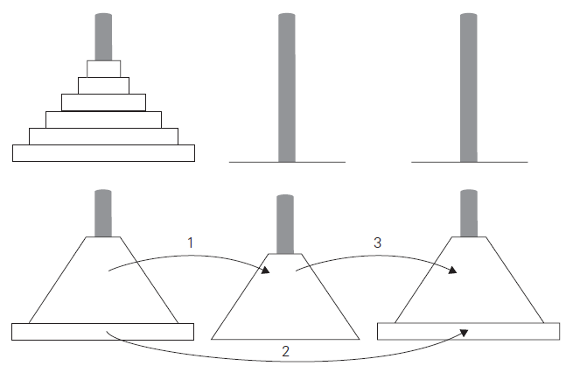
TOWER OF HANOI Problem
To move n>1 disks from peg 1 to peg 3 (with peg 2 as auxiliary), we first move recursively n − 1 disks from peg 1 to peg 2 (with peg 3 as auxiliary).
Then move the largest disk directly from peg 1 to peg 3, and, finally, move recursively n − 1 disks from peg 2 to peg 3

Slide 4
TOWER OF HANOI Problem
The number of moves M(n) depends on n only. Therefore
M(n) = M(n − 1) + 1+ M(n − 1) for n > 1, also M(1) = 1
M(n) = 2M(n − 1) + 1 and M(1) = 1 ------- 1
M(n − 1) = 2M(n − 2) + 1 ------- 2
Sub. 2 in 1
M(n) = 2[2M(n − 2) + 1] + 1
= 2²M(n - 2) + 2 + 1 ------- 3
M(n – 2) = 2M(n – 3) + 1 ------- 4
Sub. 4 in 3
M(n) = 2²[2M(n – 3) + 1] + 2 + 1 ------- 5
M(n) = 2³M(n – 3) + 2² + 2¹ + 2⁰ ------- 6
M(n) = 2⁴M(n – 4) + 2³ + 2² + 2¹ + 2⁰ ------- 7
…

Slide 5
TOWER OF HANOI Problem
In general
M(n) = 2^{i}M(n − i) + 2^{i−1} + 2^{i−2} + . . . + 2 + 1= 2^{i}M(n − i) + 2^{i} − 1.
Let i = n - 1,
M(n) = 2^{(n-1)}M(n − (n-1)) + 2^{(n-1)} − 1
= 2^{(n-1)} + 2^{(n-1)} − 1
= 2^{(n-1)} + 2^{(n-1)} − 1
= 2. (2^{(n-1)}) − 1
= 2^{(1+n-1)} – 1
= 2^{n} – 1 (Exponential growth)
If i = 3
2^{i} − 1 = 2³ – 1 = 7
2^{i−1}+ . . +2+1=2²+2¹+1=7

Slide 6
THANK YOU

